Slide 1
The Park Friendly Location in Toronto Neighbourhoods
Qisheng Yin
July 31, 2020

Slide 2
Background
John is searching for a new apartment in Toronto
John loves visit parks
The requirement for the apartment is that it must be adjacent to lots of parks in Toronto

Slide 3
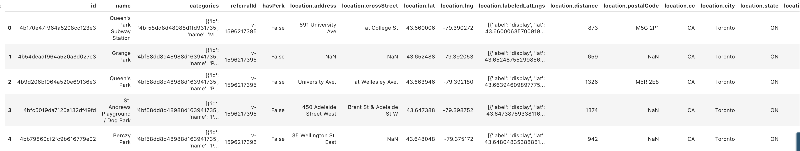
Preprocessed Location Info by Foursquare

Slide 4
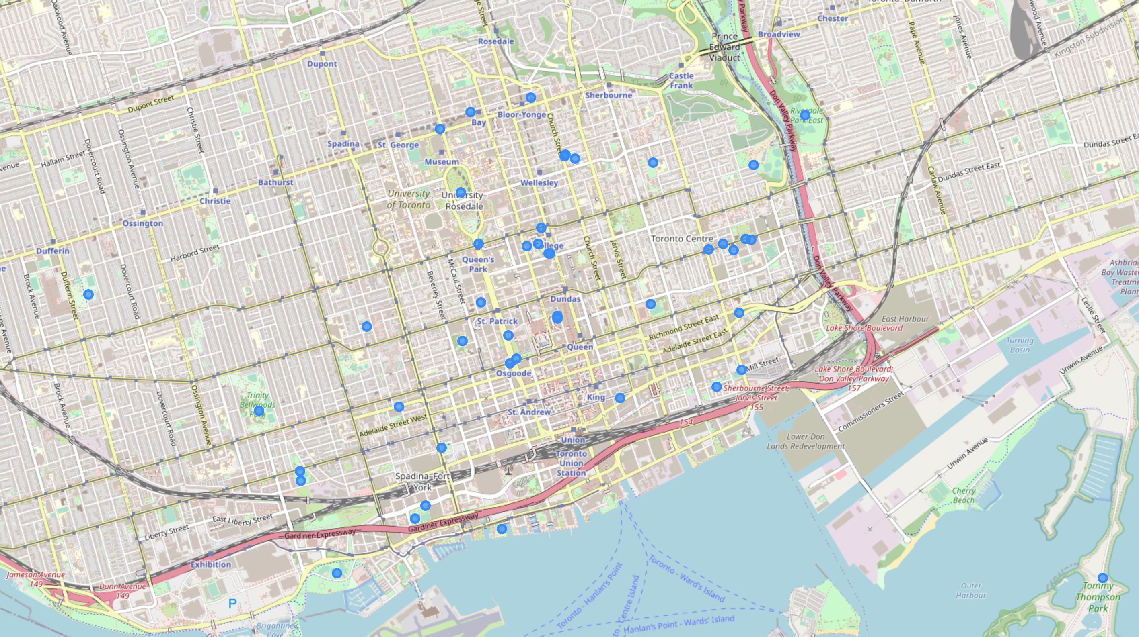
Map of the parks in Toronto

Slide 5
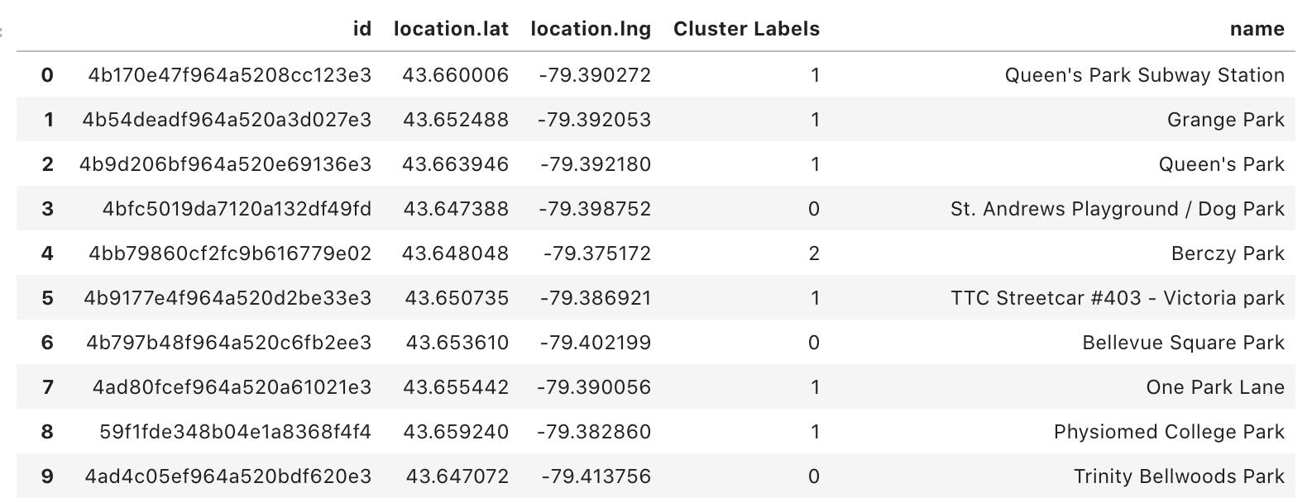
K-mean clustering
K-means clustering assigned the parks in Toronto into 5 groups.

Slide 6

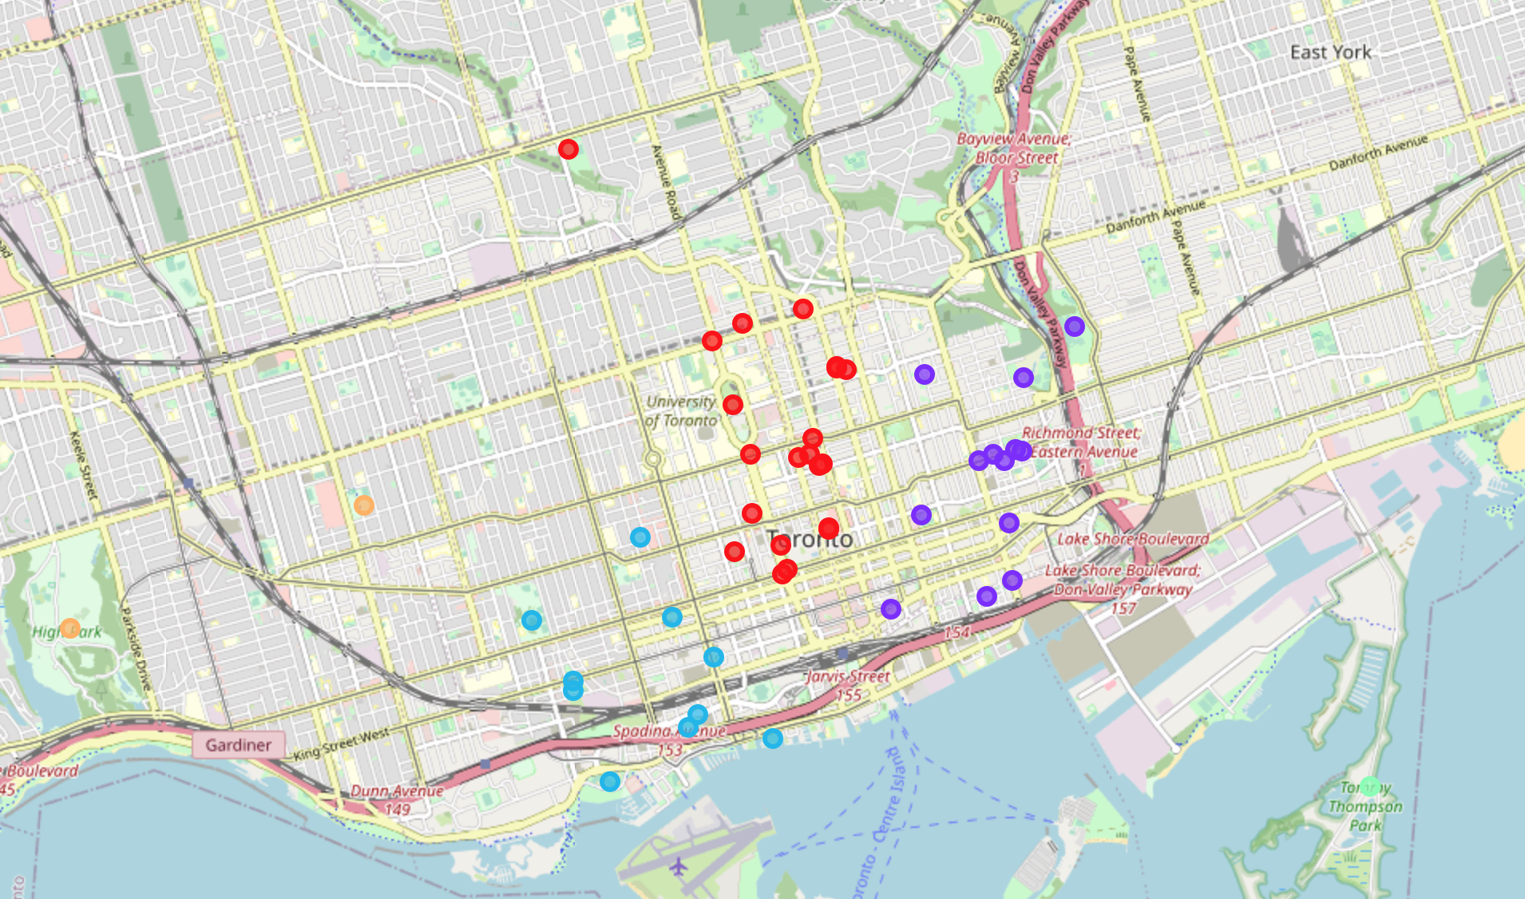
Visualization of the resulting clusters

Slide 7

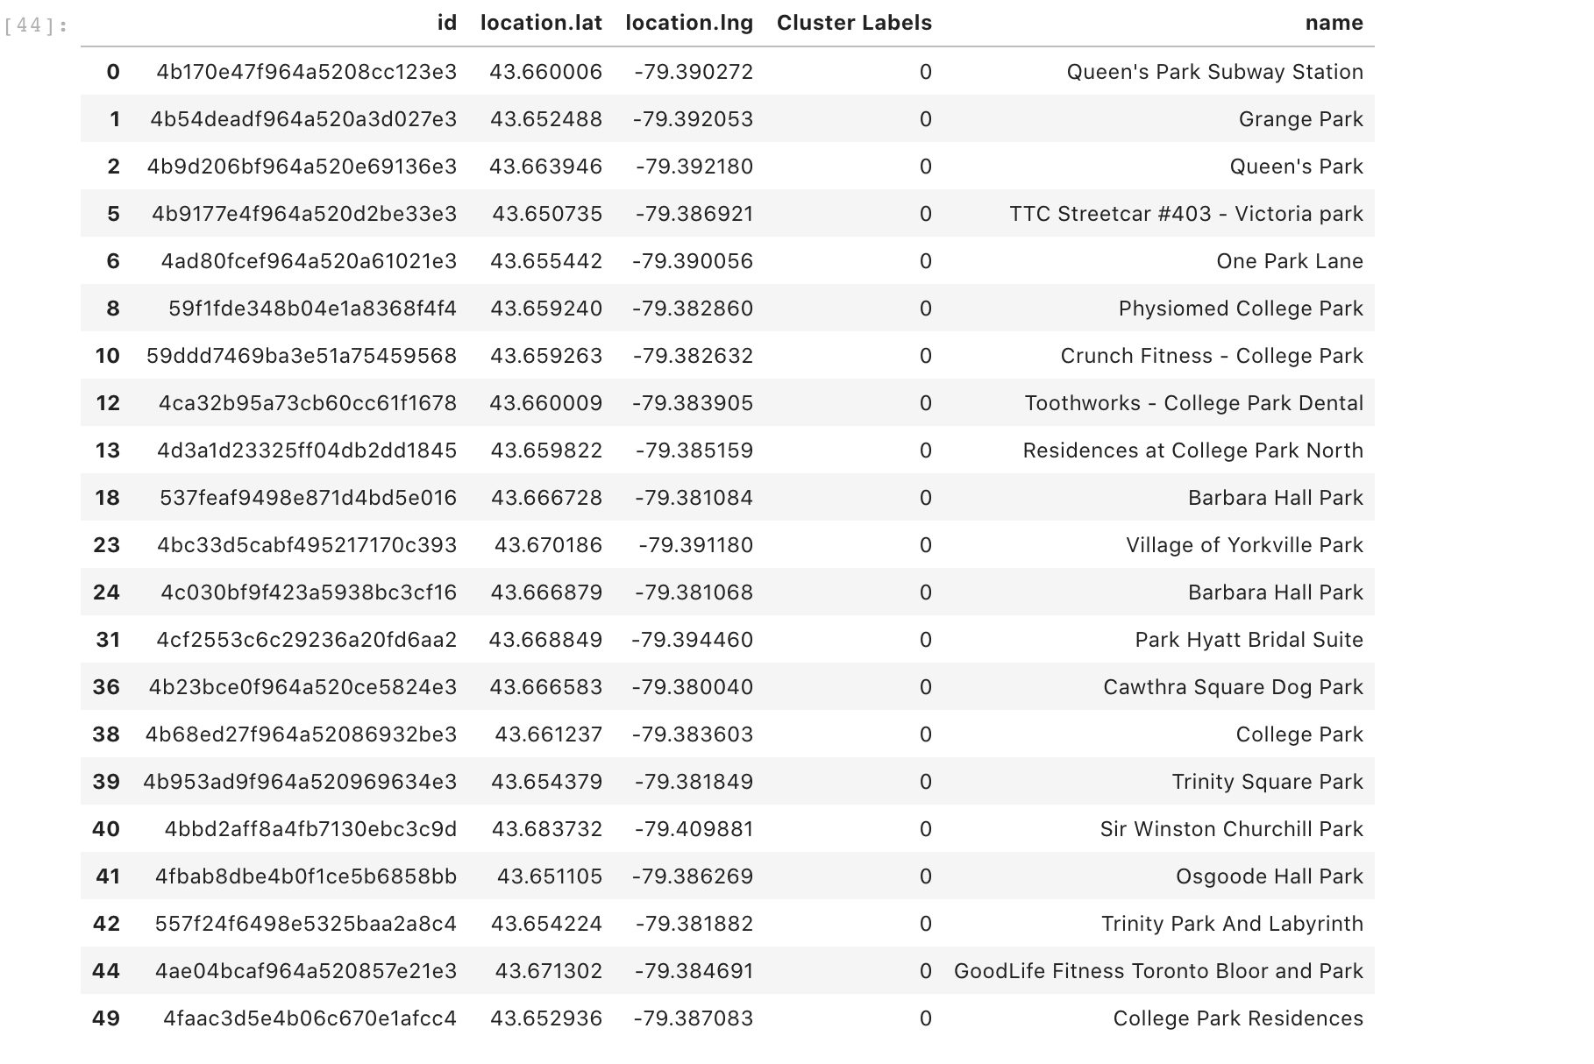



Examine Clusters
cluster 1has 21 parks in its group and it has the highest number of the parks among each cluster.

Slide 8
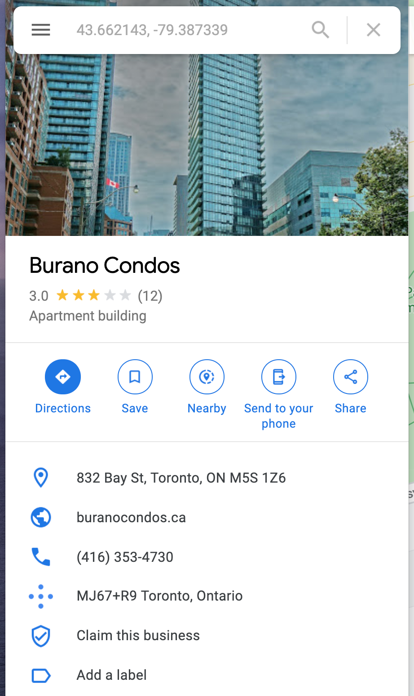
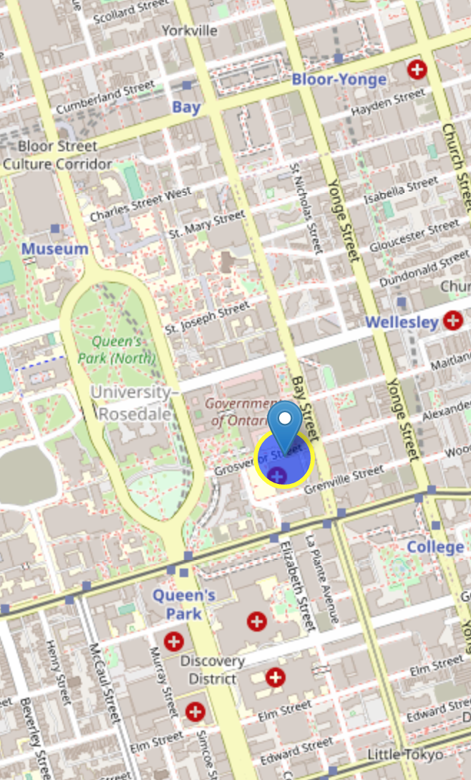
The location
Area around 80 Grosvenor St, Toronto is the place that is adjacent to the most parks in Toronto.
An example of the apartment is called Burano Condos.

